Slide 1
Airbnb Market Analysis & Pricing Optimization
Dev10 Capstone
Team AirJNJ
Data Cohort #50: Feb - May 2023
Notes:
Jeremy

Slide 2
outline
The team
Project overview
Data pipeline
Introducing members and backgrounds
Research questions and data sources
Orchestration to reporting workflow
eda
Machine learning
conclusions
Exploratory data analysis
Model selection and results
Dashboard and interpretation of results
Notes:
Jeremy

Slide 3



Jeremy garrison
Team
airjnj
Noelle kiesz
Jessica hoffman
Charleston, SC
B.S. Mathematics,
Clemson University
San Francisco, CA
B.S Exercise Science,
Northern Arizona University
Colorado Springs, CO
M.S. Chemical Engineering, Colorado School of Mines
Notes:
All

Slide 4
01.
project OVERVIEW
Exploring the vacation rental market in NYC and Paris with Airbnb and Yelp data
Notes:
Jessica

Slide 5
4,000,000 +
Airbnb hosts worldwide
Notes:
Jessica - Airbnb founded in 2008 in san francisco

Slide 6
Airbnb is a global industry disruptor
$5.9 billion
4,000,000+ Airbnb hosts
60% Women
Revenue generated in 2021
40% Men
150,000,000+ users
Around the world
6,000,000 active property listings
100,000 cities
220 countries
3500+ castles, villas, domes, lighthouses
are millennials
60%

Slide 7


Data sources
155 MB / ~285,000 rows
13.6 MB / 19.7k rows
Yelp API calls
Kaggle Airbnb listings dataset
Notes:
Jessica

Slide 8





Slide 9
Paris

Slide 10
Paris data
Paris
 | Population | AirBnB Listings | Zip Codes Analyzed | Yelp Locations Analyzed
Paris | 2.1 million | 64.7K | 20 | 2100

Slide 11
New York City

Slide 12
New York city data
 | Population | AirBnB Listings | Zip Codes Analyzed | Yelp Locations Analyzed
NYC | 8.3 million | 37.0K | 214 | 17658
New York City

Slide 13
Research questions
Is there any correlation between AirBnB ratings and nearby yelp locations
Is there a difference between NYC and Paris markets
What variables best predict the price of an AirBnB
Does population correlate to more or higher priced AirBnBs
If it is not proportional to population, is it proportional to city size
Is there a significant difference between attraction/restaurant types in NYC vs Paris
Is there a strong difference within NYC's different boroughs
Notes:
Noelle

Slide 14
02.
Data pipeline
Orchestration to reporting workflow

Slide 15
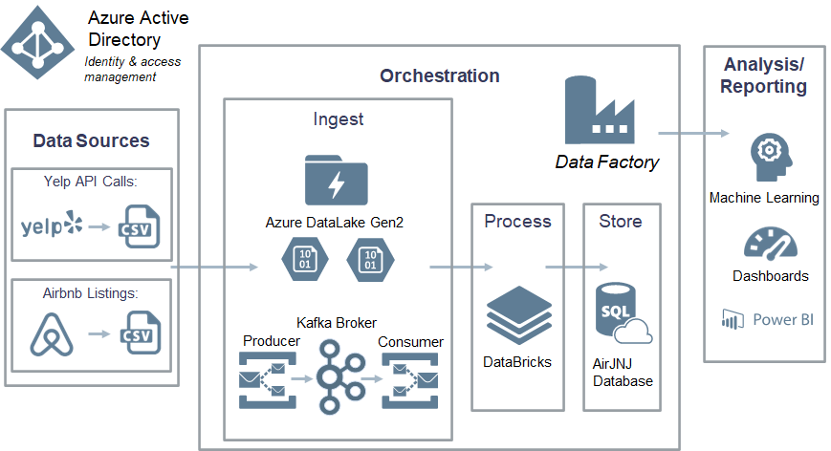
Notes:
Jeremy

Slide 16
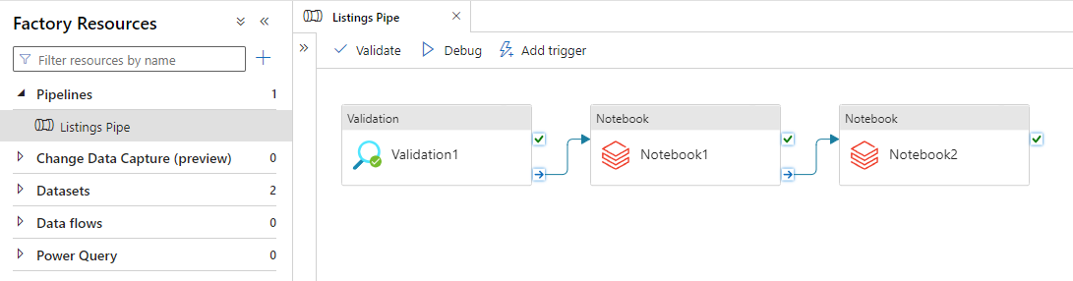
Notes:
Jeremy

Slide 17
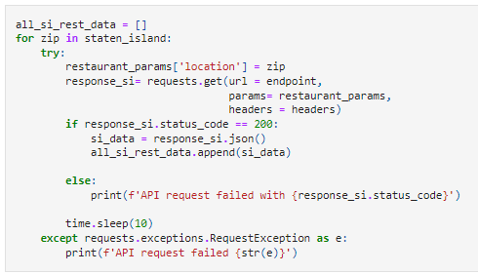
Yelp API Calls
Notes:
Noelle

Slide 18
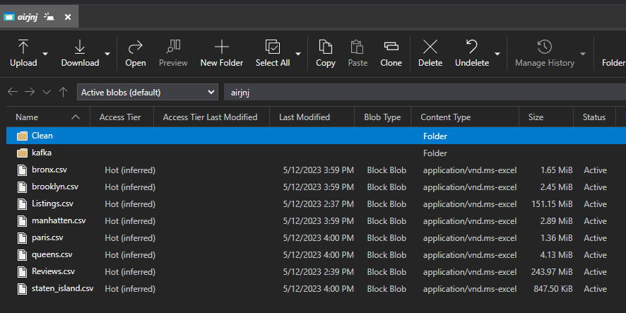
Blob Container
Notes:
Jeremy

Slide 19
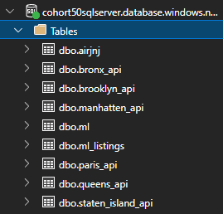
SQL Tables
Notes:
Jeremy

Slide 20
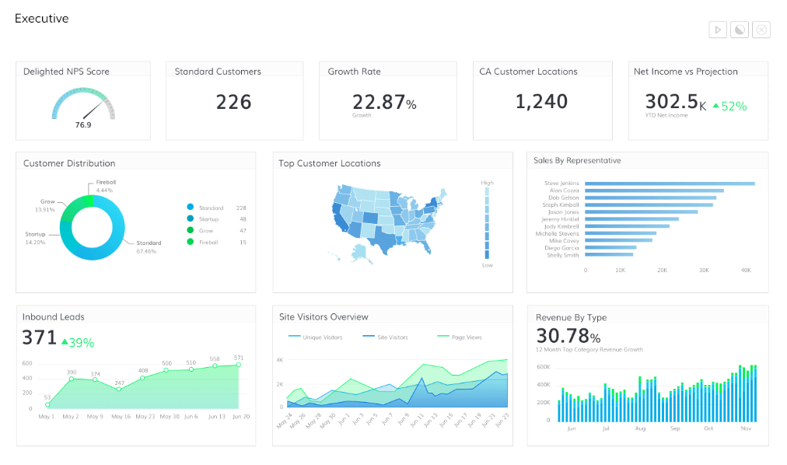
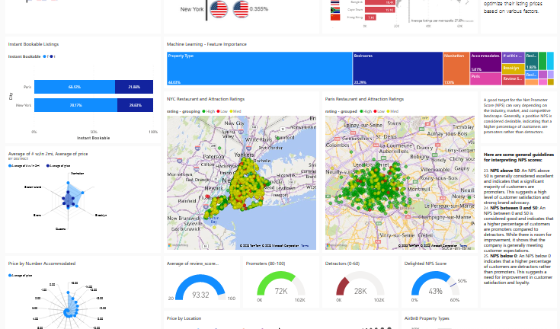


dashboard
Dashboard Link
Notes:
Jessica https://app.powerbi.com/groups/me/apps/8e6ba15d-1ed2-45c4-b5fb-ebcd539b8a61/dashboards/cca3d8c6-a7c0-4461-994a-9384c438bfe1?ctid=d4e104e3-ae7d-4371-a239-745aa8960cc9&experience=power-bi

Slide 21
03.
Exploratory data analysis
Data cleaning & exploration, feature selection, visualizations
Notes:
Noelle

Slide 22
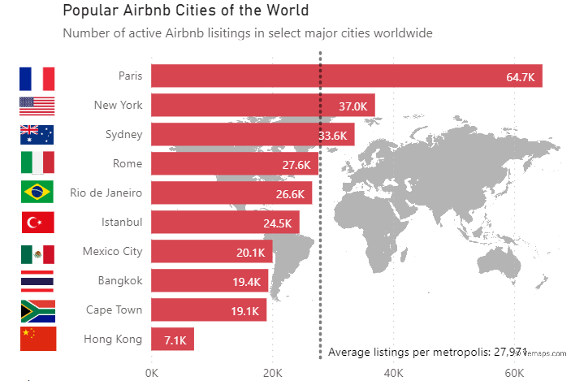
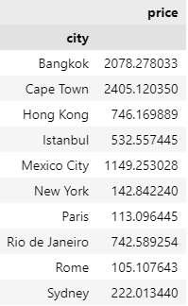
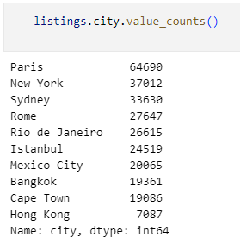
Sample selection
Nyc + Paris → 101,000 rows
Original dataset contained 279K rows
And 10 cities
Notes:
Noelle

Slide 23
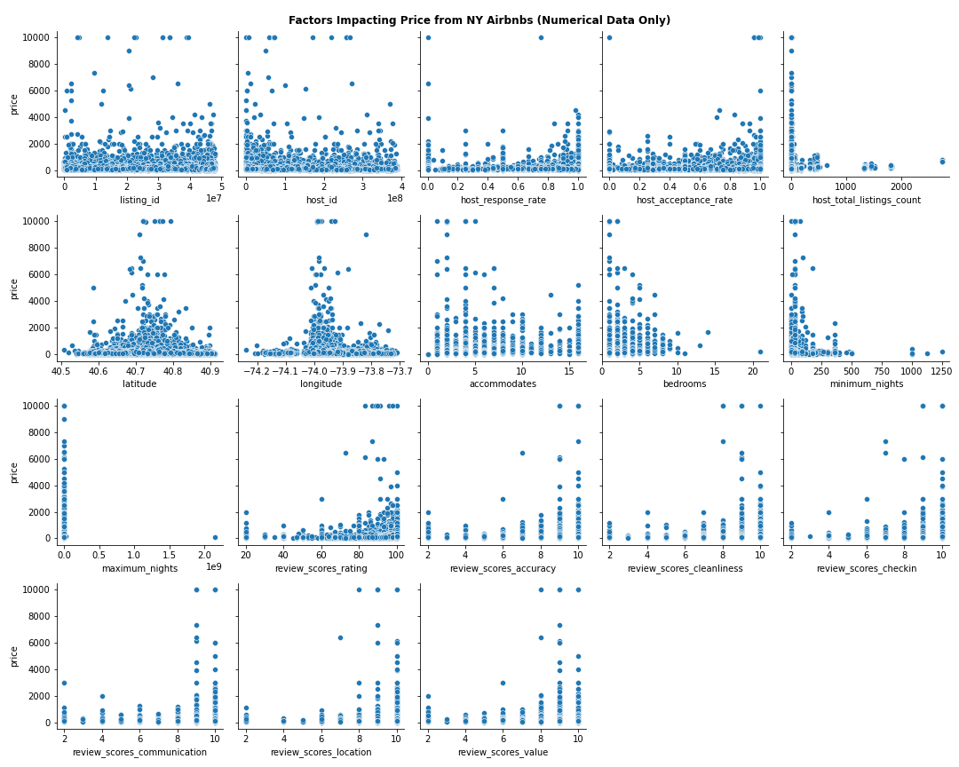
Identifying key variables
Listing_id
Name
Host_id
Host_since
Host_location
Host_response_time
Host_response_rate
Host_acceptance_rate
Host_is_superhost
Host_total_listings_count
Host_has_profile_pic
Host_identity_verified
Neighbourhood
District
City
Latitude
Longitude
Property_type
Room_type
Accommodates
Bedrooms
Amenities
Price
Minimum_nights
Maximum_nights
Review_scores_rating
Review_scores_accuracy
Review_scores_cleanliness
Review_scores_checkin
Review_scores_communication
Review_scores_location
Review_scores_value
Instant_bookable
Target vs Predictors
Pair Plots
Notes:
Noelle

Slide 24
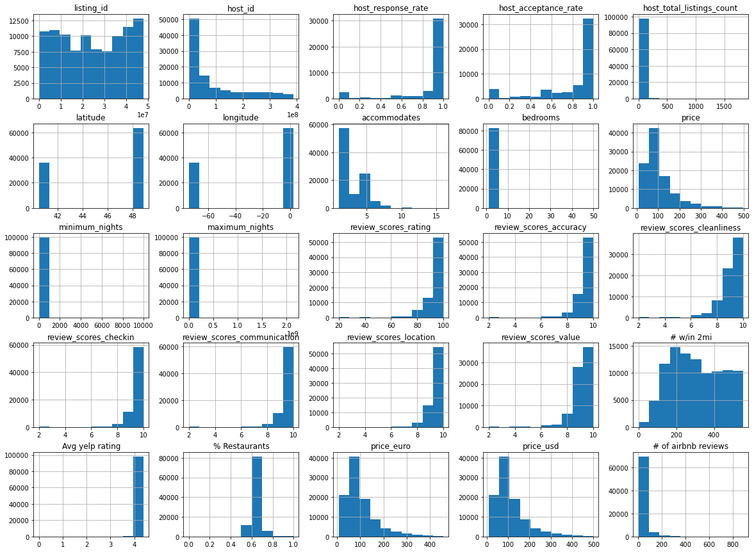
Data cleaning
Notes:
Noelle

Slide 25
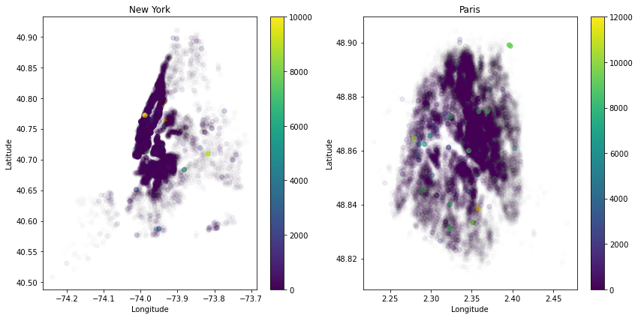
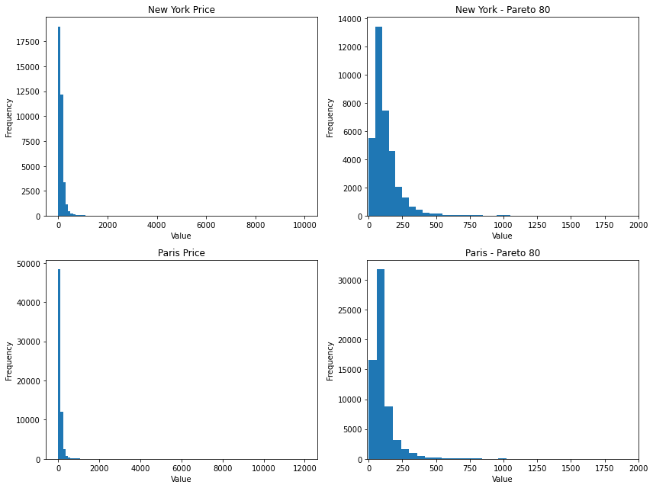
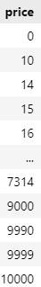
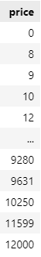
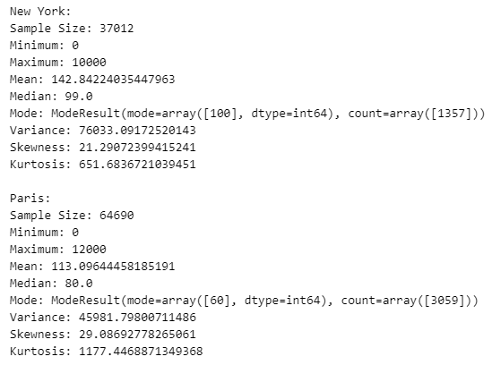
Data cleaning
target distribution
$0-$10,000 for NYC
$0-$12,000 for Paris
removing outliers
Removed listings priced at $0 (90 rows/0.08%)
Model threshold: <$500 (1648 rows/1.6%)
Notes:
Noelle

Slide 26
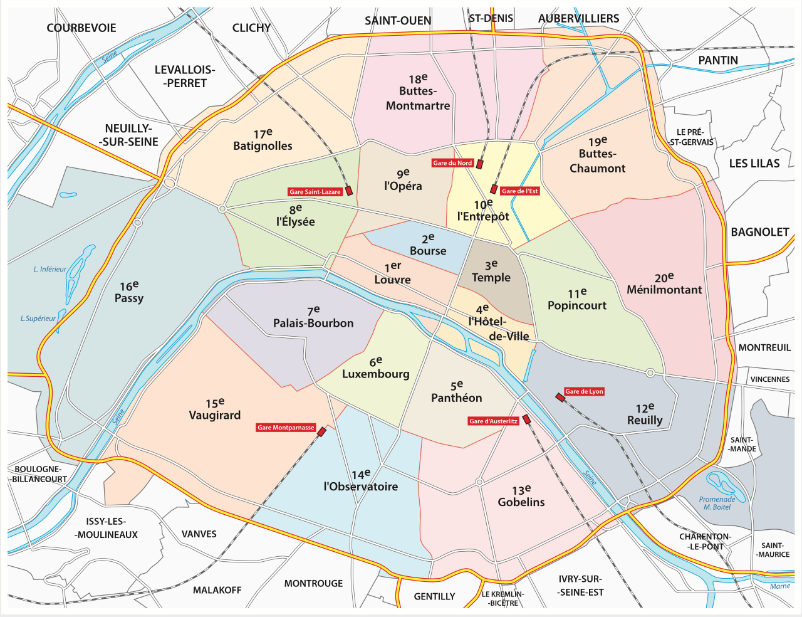
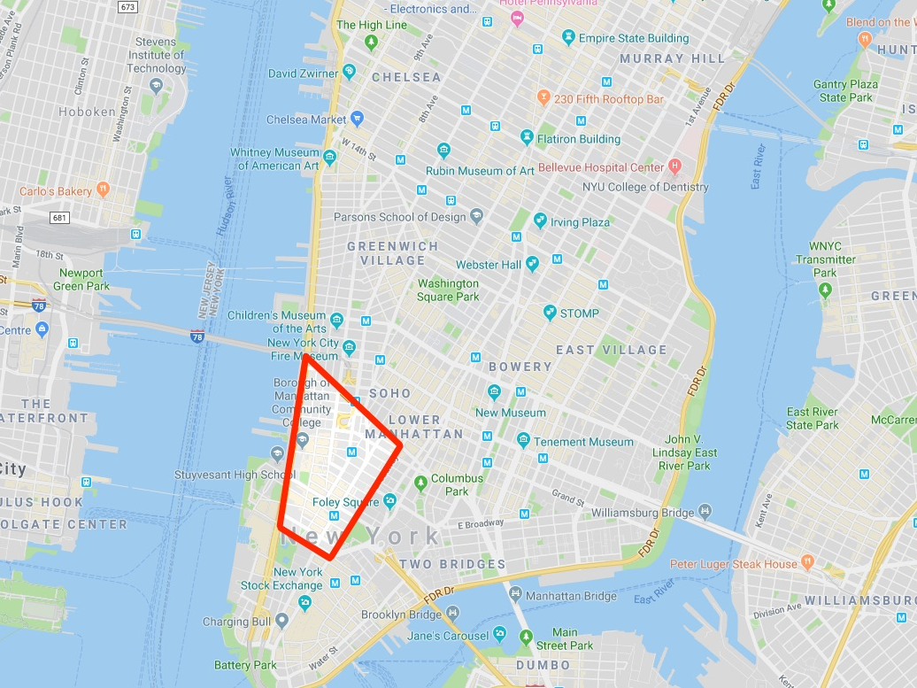
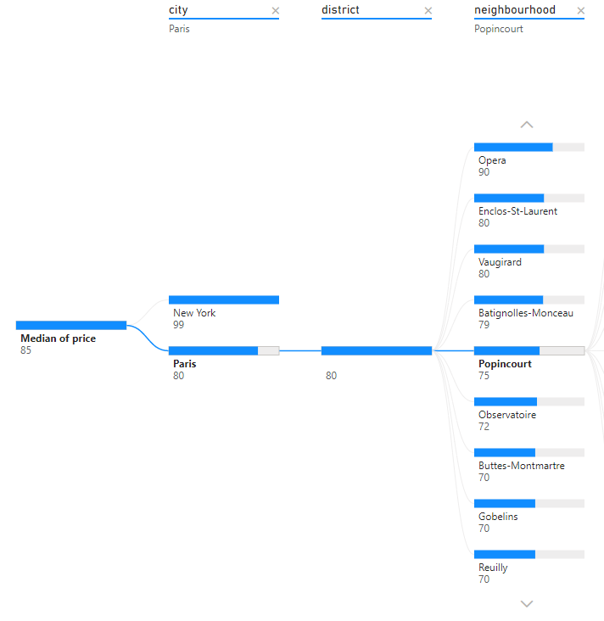
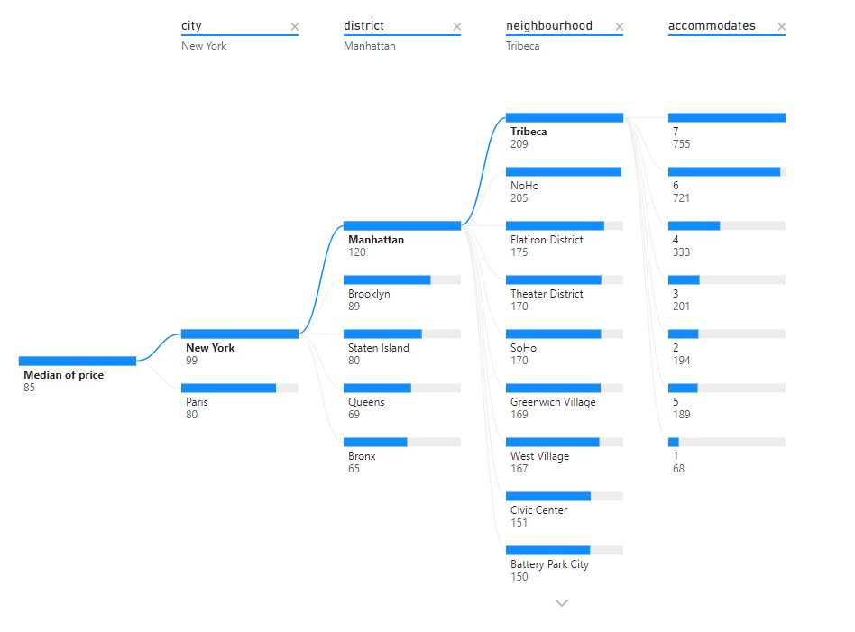
Pricing by geography discovery
Paris
New york
Opera neighborhood is most expensive
Manhattan most expensive district
Tribeca, NoHo neighborhoods
Notes:
Noelle

Slide 27
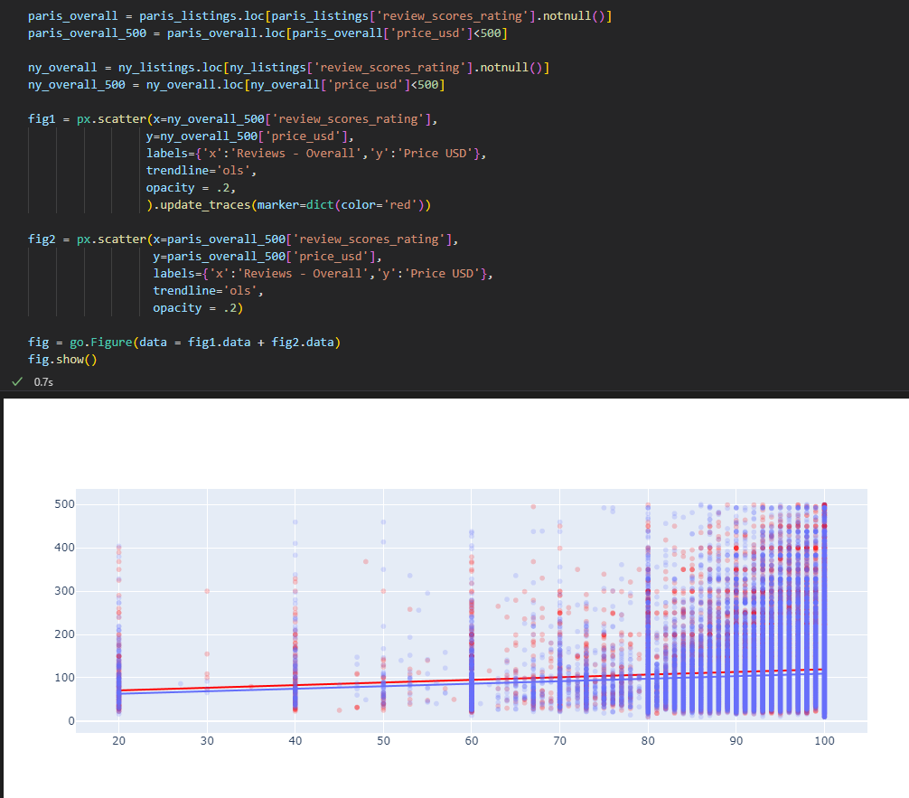
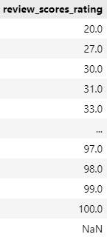
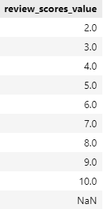
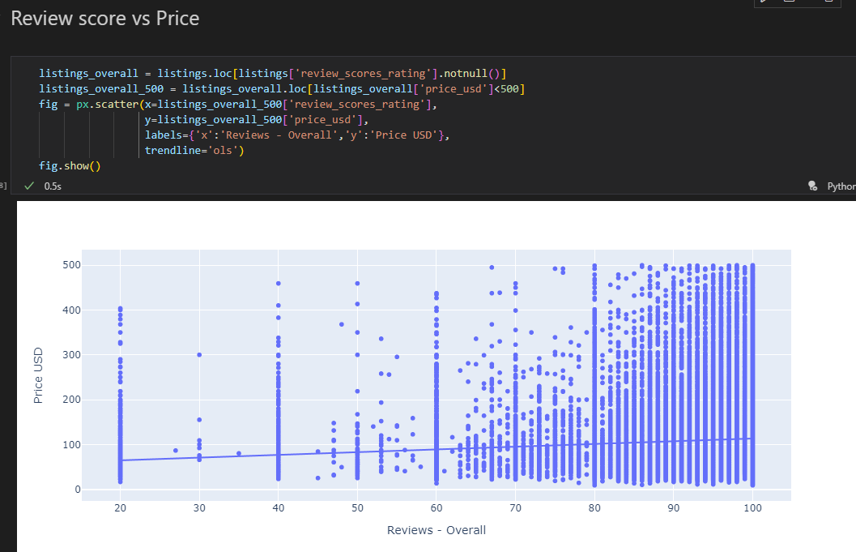
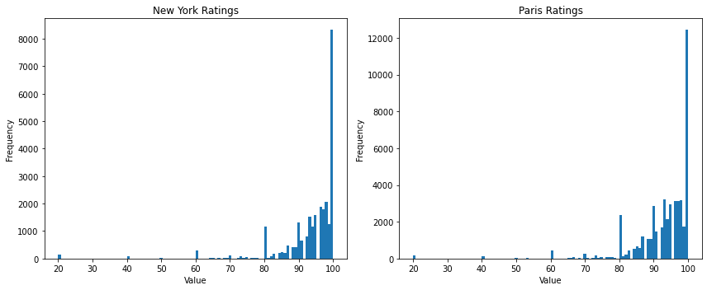
Ratings vs price discovery
Overall listing ratings: 0-100
Ratings for each category (i.e. cleanliness): 0-10
Distribution is polarized and left-skewed
mostly positive reviews (mean: 93%)
few extreme negative reviews (peaks: 20%, 40%)
few moderate (peak: 60%)
Notes:
Jeremy

Slide 28
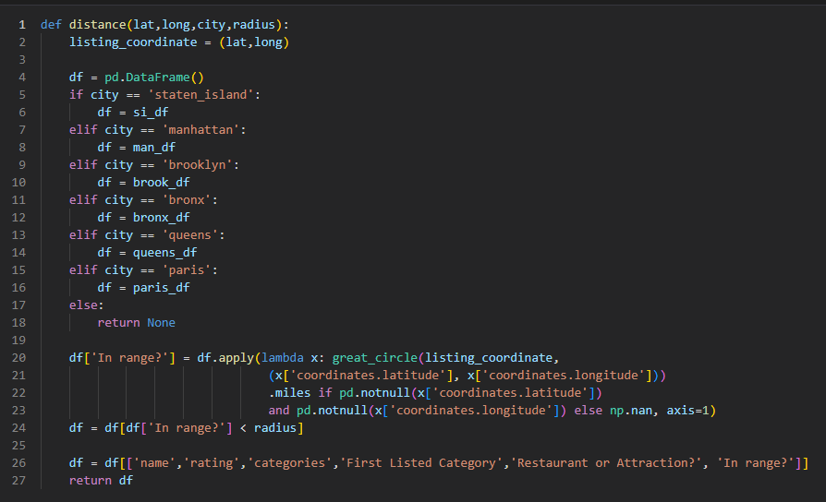
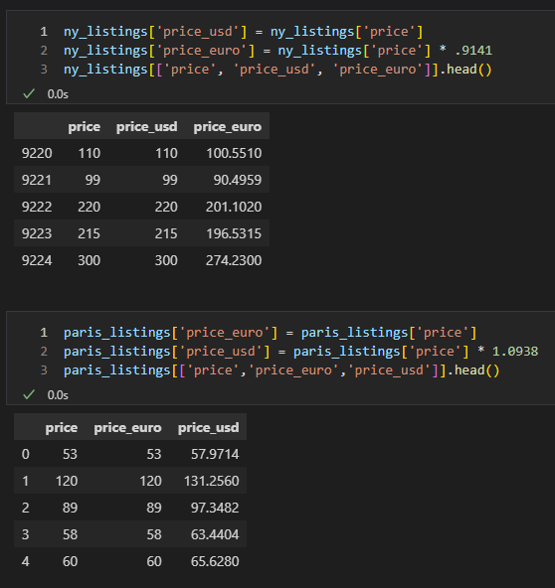
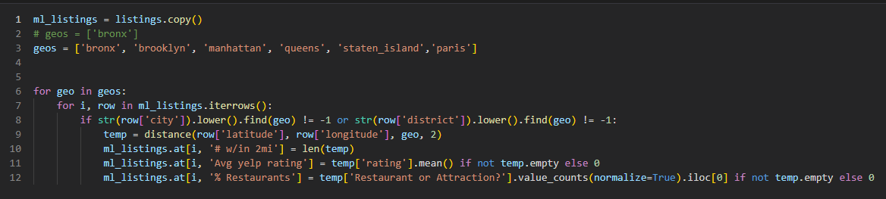
Created Columns
price_euro and price_usd
# of airbnb reviews
# w/in 2mi
Avg yelp rating
% Restaurants
Notes:
Jeremy

Slide 29
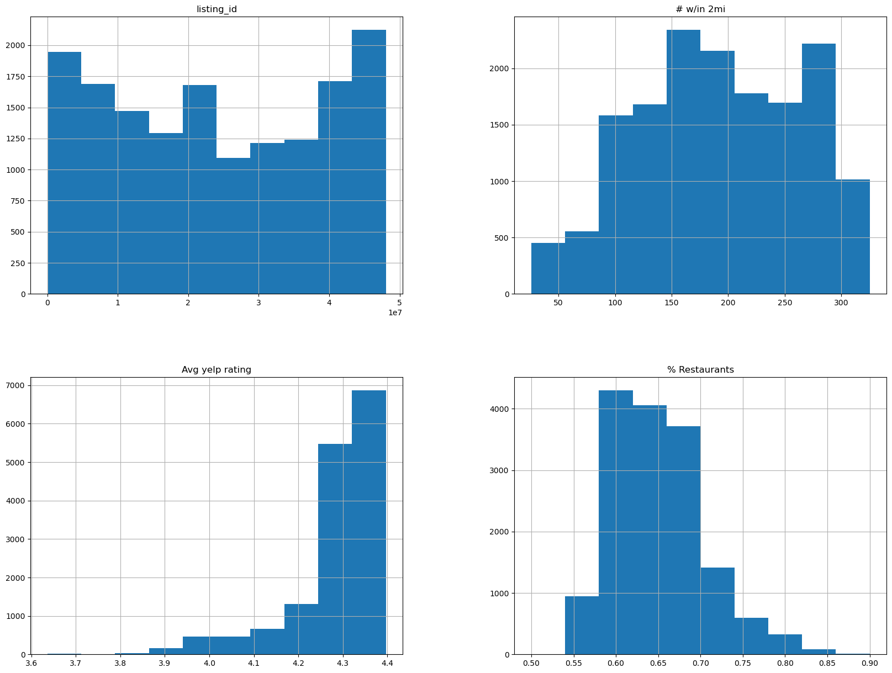
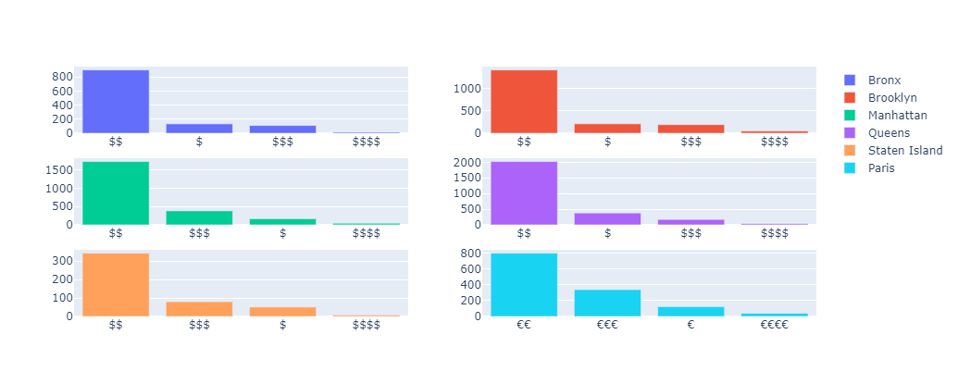
Yelp attractions discovery
Notes:
Jeremy

Slide 30
Potential Issues?
Year Difference
AirBnB data - 2021
Yelp API calls - 2023
NYC and Paris Public Transportation
Many options to get around the city, so the radius of Yelp Attractions might not be a large factor
Distance Calculation
Driving distance vs Actual distance
Notes:
Jeremy

Slide 31
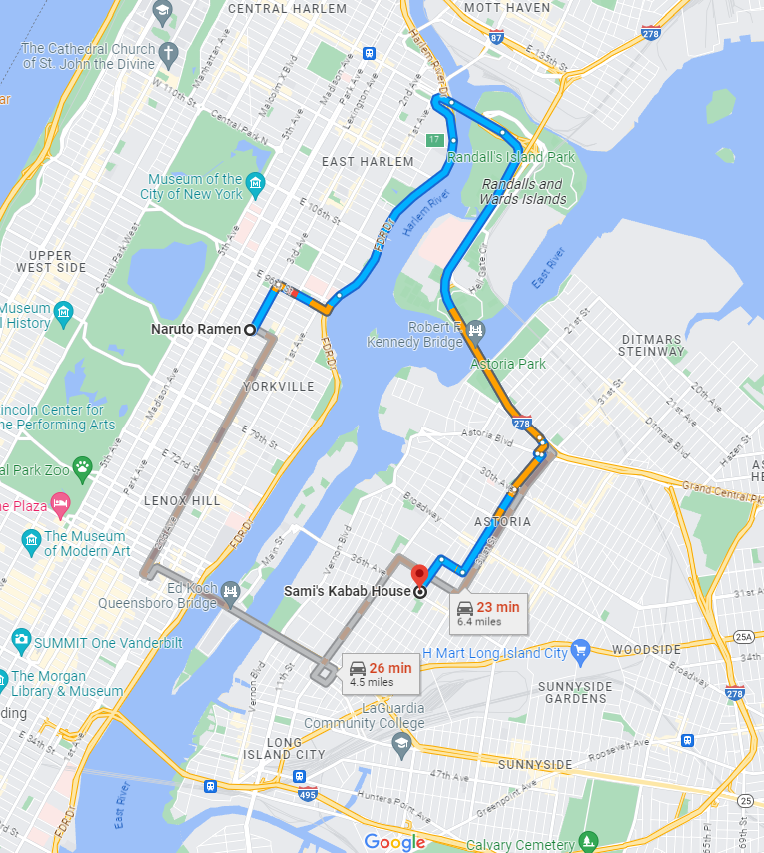
Driving Distance
Notes:
Jeremy

Slide 32
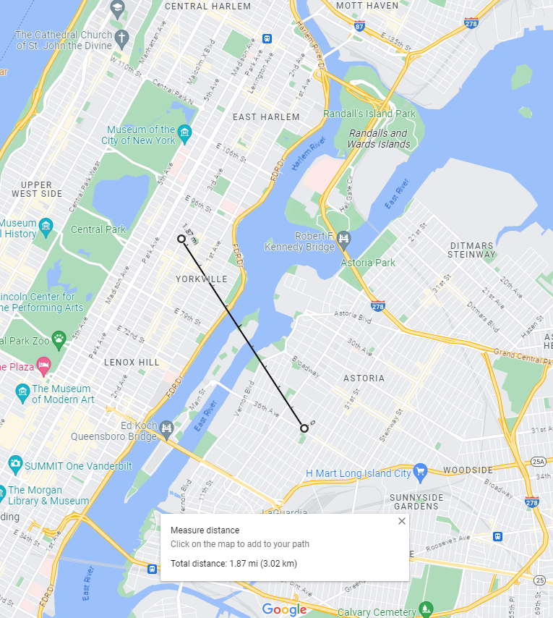
Actual Distance
Notes:
Jeremy

Slide 33
04.
MAchine learning
Model selection and results
Notes:
Jessica

Slide 34
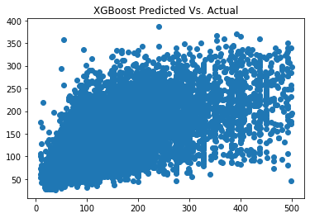
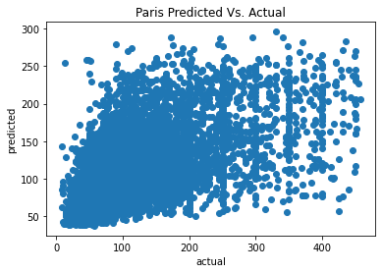
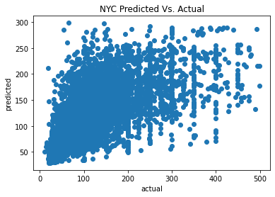

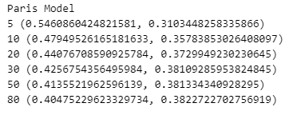
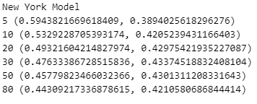
Model comparison
Best Xgboost score: 0.496
Best knn score: 0.434
Notes:
Jessica

Slide 35
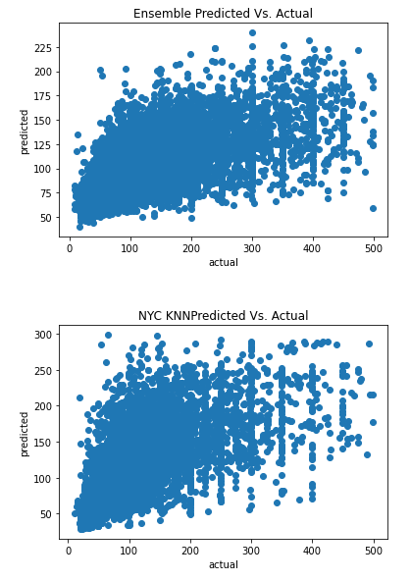
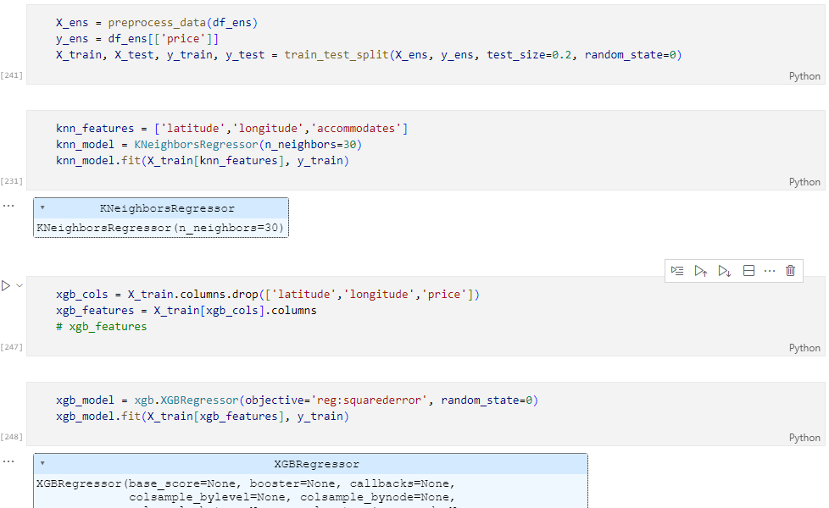
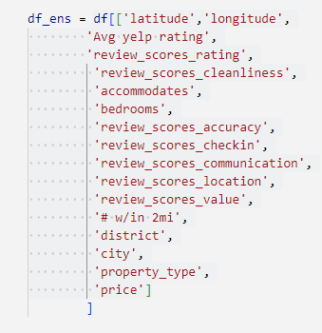
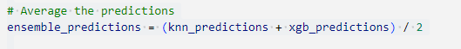
Ensemble effect
Ensemble r-squared score: 0.328
Tighter spread but reduced score
Underpredicted more often
Overall more conservative pricing model, but more stable
Notes:
Jessica

Slide 36
05.
conclusions
Dashboard and interpretation of results

Slide 37
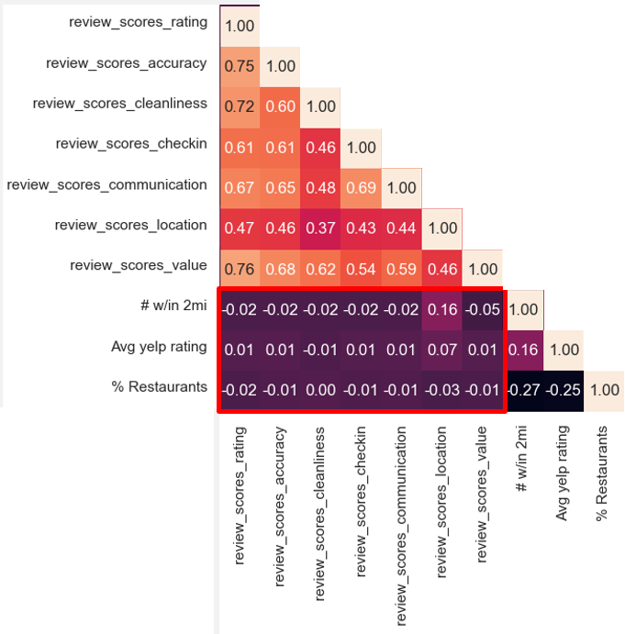
Is there any correlation between AirBnB ratings and nearby Yelp locations?
There was very little correlation between AirBnB ratings and nearby Yelp locations
Notes:
Noelle

Slide 38
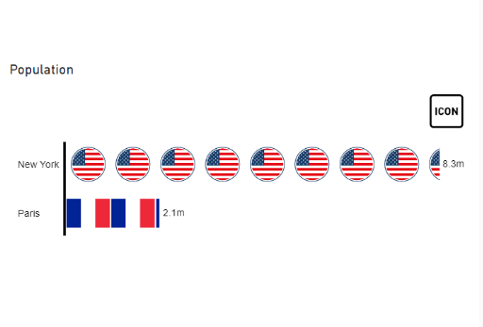
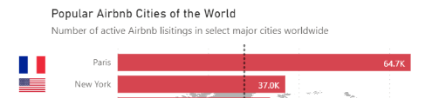
Does population correlate to more or higher priced AirBnBs?
New York has four times the population of Paris, yet Paris had twice as many AirBnB listings
Notes:
Noelle

Slide 39
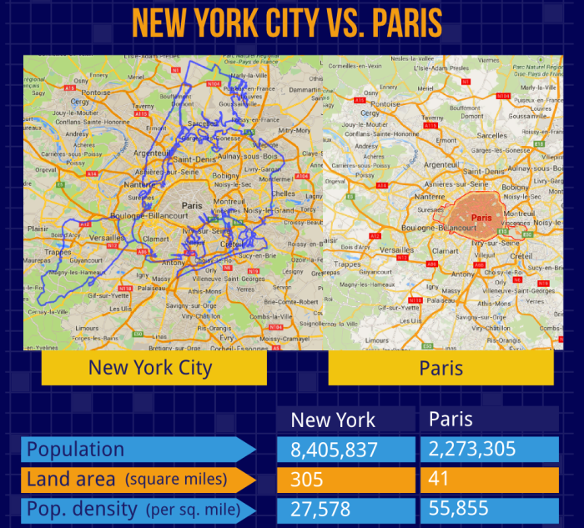
If it is not proportional to population, is it proportional to city size?
New York City is about 7 times larger than Paris, but still has about half the AirBnB listings Paris does.
Source
Notes:
Jeremy

Slide 40
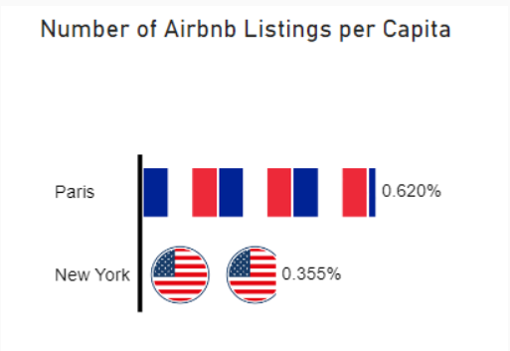
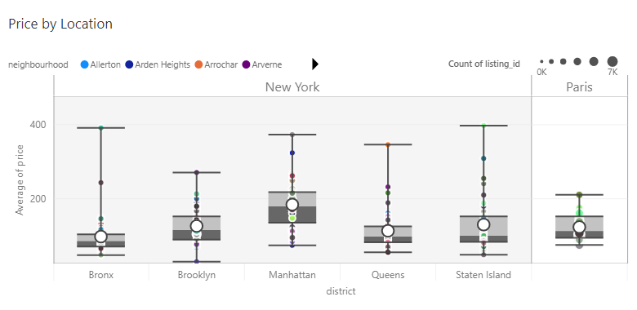
Is there a difference between NYC and Paris markets?
Paris has a larger amount of AirBnB listings per Capita, but the prices are similar between both cities
Notes:
Jeremy

Slide 41
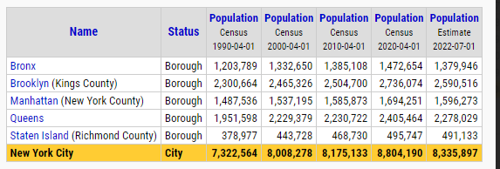
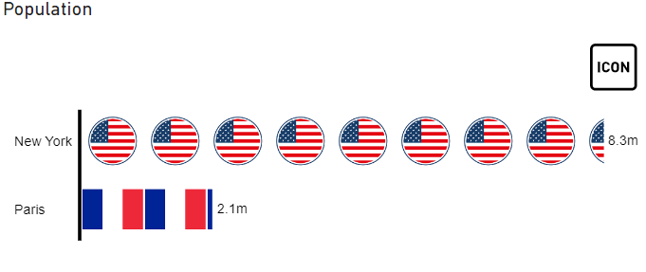



Population density comparison
Notes:
Jeremy

Slide 42

Is there a strong difference within New York City’s different boroughs?
The prices were similar, however the total number of listings varied drastically, with Manhattan and Brooklyn hosting the vast majority of AirBnBs
Notes:
Jeremy

Slide 43


What variables best predict the price of an AirBnB?
KNN:
Latitude
Longitude
Accommodates
Notes:
Jessica

Slide 44


Is there a significant difference between attraction/restaurant types in NYC vs Paris
With Paris’s smaller size, we had a much smaller Yelp dataset to work with. Regardless, we see similar cuisine distributions between the two cities
Notes:
Jessica

Slide 45
debrief
What would we do differently with more time or try for future studies?
Use cross joins
iterating over dataframes is computationally expensive
Different radius for yelp API call
Metropolis areas have so many returns in 2 miles it became nonfactor
Find/webscrape Airbnb dataset with suburban listings
Surrounding attractions are greater factor
Add more machine learning models to ensemble
Lasso regression, random forest, time series
Investigate seasonality or other temporal effects (COVID era)

Slide 46
RESOURCES
websites
https://www.kaggle.com/datasets/mysarahmadbhat/airbnb-listings-reviews
https://www.yelp.com/developers/documentation/
https://medium.com/@UpOutNYC/cool-map-overlays-show-nyc-s-size-compared-to-other-major-cities-6244dc2616f1
Notes:
Jessica

Slide 47


Get in touch
www.linkedin.com/in
/jessica-l-hoffman
/jmgarris
/nkiesz
github.com/garris9/AirJnJ
jhoffman@dev-10.com
jgarrison@dev-10.com
nkiesz@dev-10.com
Notes:
Jessica

